Slide 1
The Apps Project
1st of May, 2023.
Overview:
A marketing consulting firm which is into consulting and advisory services currently aims to suggest either of Google Play apps or Apple Store apps, based on whichever has higher user reviews, to her client - an operating systems design company that seeks to build a major apps store into its user interface.

Slide 2
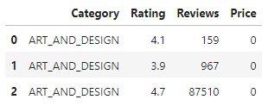
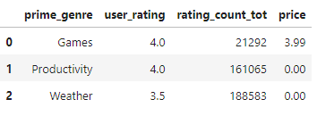
Data Sourcing -> Cleaning -> Transforming.
The datasets were sourced from Kaggle and the features having relevance to the project were extracted for adoption. The features and the first few rows are shown below.
1st three rows in google & Apple apps datasets, respectively, below.
The main features of interest in the dataset for apple have the required datatypes for ease of processing while the columns titled “Reviews and Price” in google dataset were of object datatypes which were cleaned and transformed to numeric datatypes (Integer and float, respectively).
The two datasets were joined through an introduced column titled “platform” and the null values were dropped from the combined datasets.
Attention was given only to the filtered data having apps that had been reviewed at least once.
A statistical summary described the dataset showing the mean as given in the next slide.

Slide 3
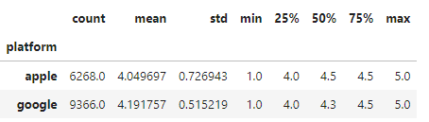
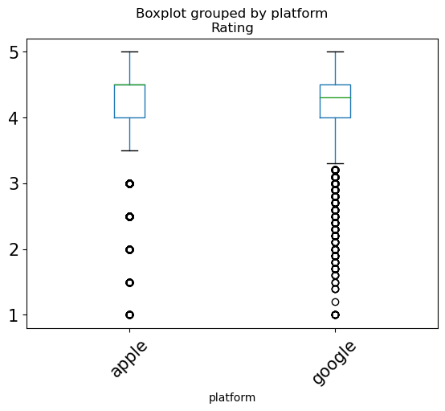
Data Visualization.
The 1st screen shot is a statistical summary that described the dataset as having mean ratings of ≈ 4.05 and ≈ 4.19 for Apple and Google apps respectively, yielding an observed difference of ≈ 0.14
The description also reveals that the respective median of 4.5 and 4.3 for Apple and Google apps ratings are higher than their mean ratings suggestive of unsymmetric distributions with some negative skewness.
This led to an embrace of non parametric, permutation test, suitable for non normal distributions.
The 2nd is a box plot visual showing similar behaviour of both apps’ ratings.

Slide 4
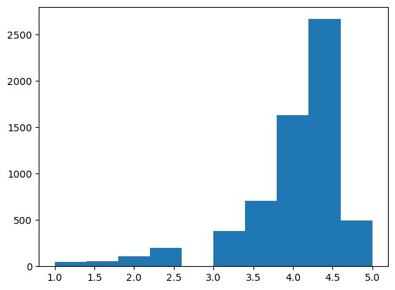
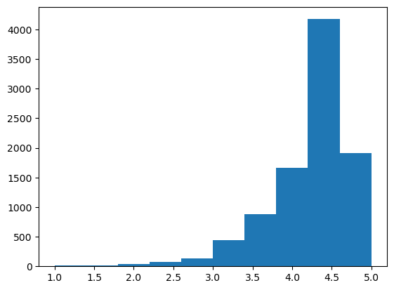
Data Modelling.
Apple
Hypothesis formulation:
H_{null}: The observed difference in the mean rating of Apple Store and Google Play apps is due to chance (not due to platform)
H_{alternative:} The observed difference is not due to chance (rather due to platform).
A 5% level of significance was adopted.
A statistical normal test was performed on ratings of both platforms (apple and google) by employing the normal test method from python scipy library which yield p-values of zero that are far less than 0.05 level of significance, implying that the null hypothesis stating normal distribution with attribution of observed difference to chance does not hold.
Histogram visuals of both platforms ratings distribution also show non normal distribution of the data.
Google

Slide 5
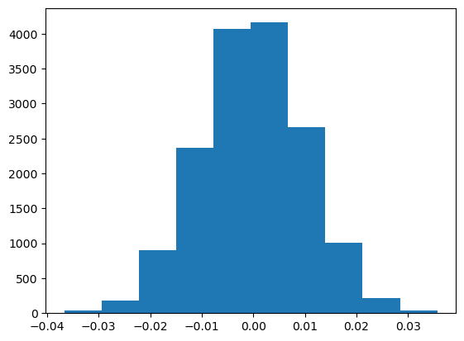
Findings and Recommendation.
Histogram of Null distribution (showing difference in platforms mean ratings)
The permutation test conducted, through shuffling the rating column yielded a mean difference in platform rating of ≈ 0.012 which is hugely different from our observed difference of ≈ 0.142 indicative of significance of our observed difference, also suggesting the null hypothesis to be false.
This was further corroborated by rendering the shuffling in about 10,000 times and checking the distribution of the difference in mean rating of the platforms showing approximately symmetrical null distribution.
Based on the p-value of zero (which is less than the level of significance @ 0.05) that resulted from the normal test conducted, supported by the mean rating difference of ≈ 0.012 from permutation test which is hugely different from our observed difference of ≈ 0.14, we reject the null hypothesis that the observed difference is due to chance.
The rating reviews of Google Play apps is more than that of Apple Store apps at 5% level of significance (even if level of significance is reduced) and the recommendation is for the client to build Google Play apps into its user interface.

